Slide 1
Nucleic Acids
Overview

Slide 2
Focus on:
Structure of DNA/RNA – can I draw it or interpret drawings
DNA Replication – can I describe the basic process
RNA Transcription – can I explain role of each type of RNA
Biosynthesis of Proteins – can I explain the basic process
Miscellaneous Topics – could I discuss each one
Cancer/Chemotherapy
Genetic Engineering
Human Genome Project
Genetic Code (Codons)

Slide 3
Structure
5 Bases

Slide 4
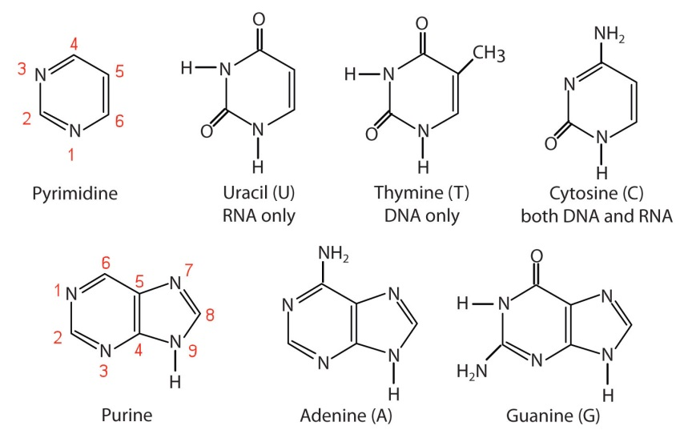
Focus on:
Molecules given on cheat sheet
Can I # the molecules and recognize which N-H group reacts
Purines/Pyrimidine pairs G/C and A/T or A/U

Slide 5
Structure
Sugars

Slide 6
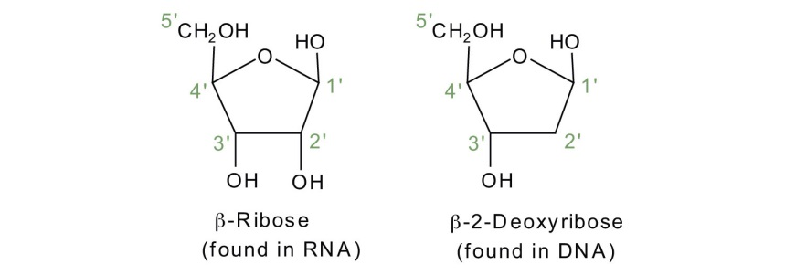
Focus on:
Molecules given on cheat sheet
Can I # the molecules and recognize which OH groups react
Missing 2’ OH on deoxyribose

Slide 7
Nucleosides

Slide 8
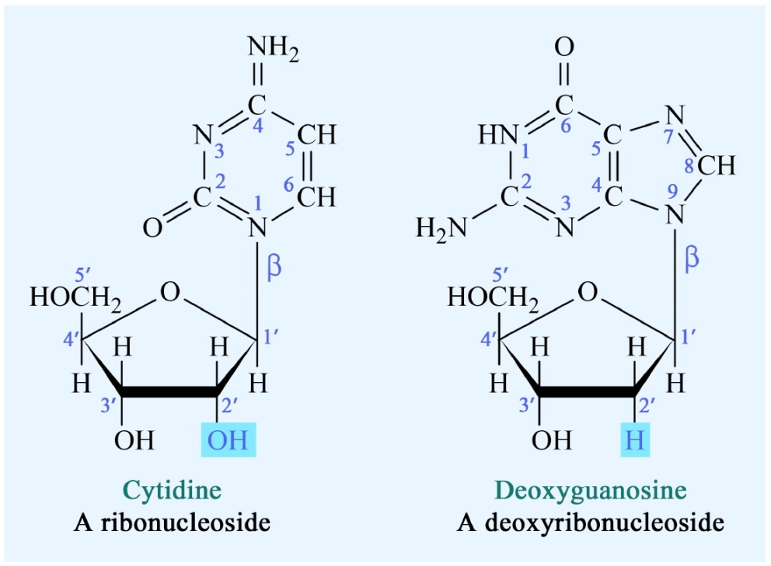
Focus on:
Given Table 31.1 on cheat sheet
Base + Sugar
2° Amine + Alcohol → 3° Amine
Dehydration Reaction
Be able to draw them

Slide 9
Nucleotides

Slide 10
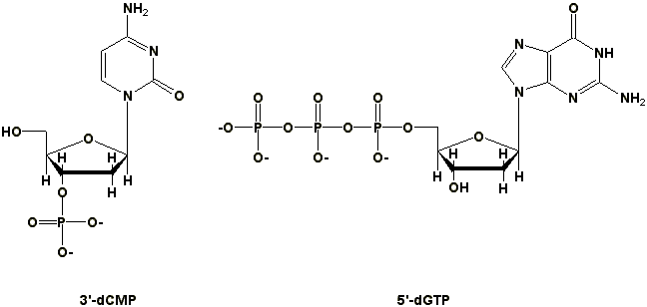
Focus on:
Given Table 31.1 on cheat sheet
Base + Sugar + Phosphate
Phosphate Anhydride Bonds
Draw and Name them
Dehydration Reaction
Naming/Abbreviations
Phosphates can connect to Ribose 2’,3’,5’, Deoxyribose 3’,5’
deoxycytidine – 3’-diphosphate
guanosine-5’-triphosphate

Slide 11
Parts of Nucleotide

Slide 12
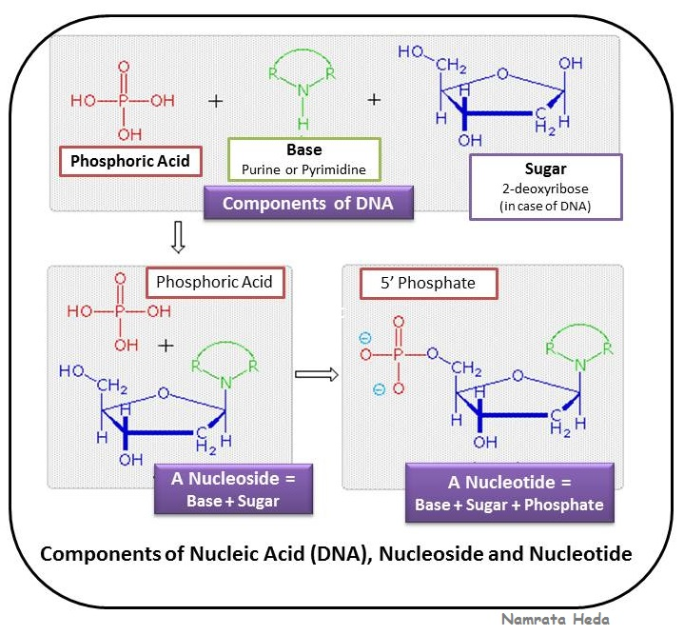
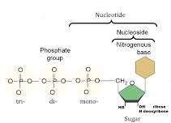

Slide 13
DNA

Slide 14
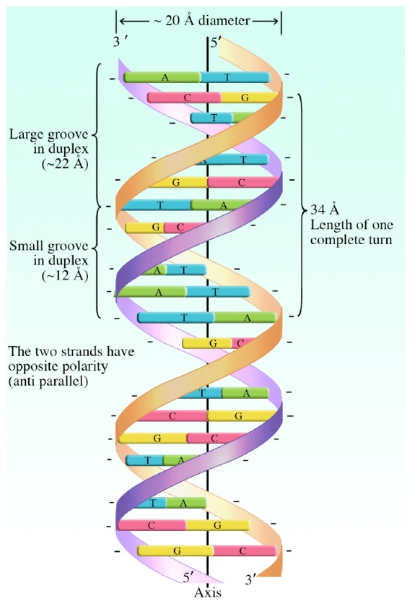
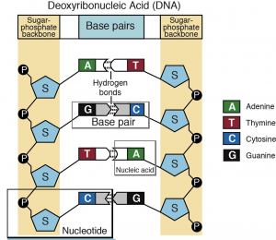
Focus on:
Draw a small segment
Double Helix with Bases = rungs
Held together by Hydrogen Bonds
Complementary

Slide 15
Complimentary
Base Pairs

Slide 16
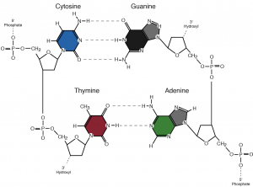
Focus on:
Hydrogen Bonds
G/C and T/A
Built in Error Checking

Slide 17
Replication

Slide 18
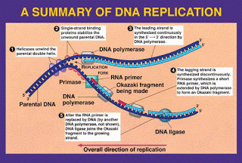
Definition: process by which DNA is duplicated
Complementary nature is key to duplication
Each new strand is 1 template + 1 new complementary strand
Strands copied differently
Towards the point of unwinding → continuous synthesis
Away from the point of unwinding → fragmented synthesis
Rigorous error checking: 1/Billion error rate

Slide 19
DNA vs RNA

Slide 20
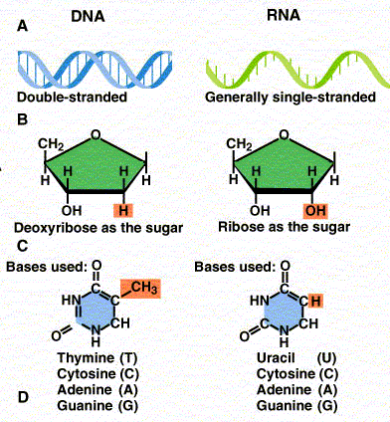
Differences between DNA and RNA
DNA | RNA
Double Strand | 1. Single Strand
Dexoyribose | 2. Ribose
3. T | 3. U
Store Information | 4. mRNA/rRNA/tRNA Blueprint/Machinery/Dump Truck
5. Unmodified | 5. Heavily Modified

Slide 21
RNA - General

Slide 22
RNA – Summary
3 main types
rRNA = ribosomal → machinery (80%)
mRNA = messenger → blueprint
tRNA = transfer → dump truck
Single Strand
U instead of T
Complimentary to DNA (HB)
Heavily Modified
Methylation (add CH₃)
Saturation of C=C
Isomerization of ribose

Slide 23
rRNA

Slide 24
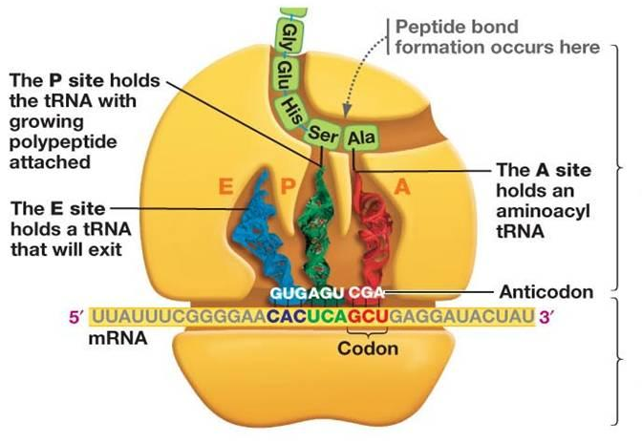
Ribosomal RNA
80% of RNA
Combines with proteins to make ribosomes
Machinery to synthesis proteins (30-35% rRNA, 60-65% protein)
Complicated structure (skip)
Small Subunit:
21 different proteins
+ rRNA
Large Subunit:
34 different proteins + rRNA

Slide 25
mRNA

Slide 26
Messenger RNA
Carries information from DNA to Ribosome
Blueprint
Undergoes some modification
More than just Blueprint
Includes 5’ cap group
Untranslated regions – where ribosome can interact
Coding region
3’ tail

Slide 27
tRNA

Slide 28
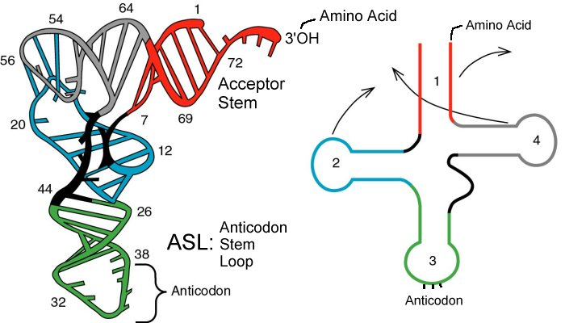
Allosteric Regulation:
Transfer
Dump truck
Bring AA to Ribosome – Interacts with ribosome, AA and mRNA
Unique cloverleaf shape – 3 important regions
1 - Acceptor Region – binds to AA
2,4 – Ribosome handles – interact with ribosome
3 - Anticodon region – binds to mRNA

Slide 29
Other Types of
RNA

Slide 30
ncRNA (Noncoding RNA)
Control flow of genetic information
Know 1 example
Hot new area to research for curing genetic diseases
Type | Size | Location | Purpose
Micro (miRNA) | 20-25 | Cytoplasm | Stop translation by blocking ribosomes
Small Nuclear (snRNA) | 60-200 | Nucleus | Control post transcription modification
Small Nucleolar (snoRNA) | 70-100 | Nucleolus | Control modification of rRNA
Small Interfering (siRNA) | 20-25 | Cytoplasm | Stop translation by triggering mRNA destruction

Slide 31
siRNA

Slide 32
siRNA
Stops translation by signaling
the destruction of mRNA before
it is translated into a protein

Slide 33
Genetic Code

Slide 34
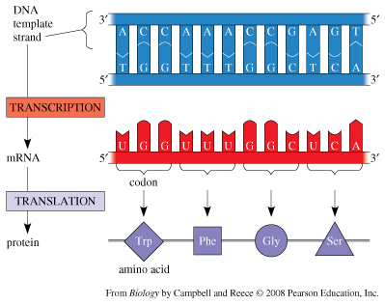
Genetic Code:
Given on cheat sheet, just know how to use it
Understand complementary relationships
G/C and A/T/U
Convert sequences
DNA ↔ mRNA
mRNA ↔ tRNA
DNA ↔ AA Sequence

Slide 35
Cancer

Slide 36
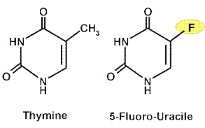
Cancer:
Oncogenes: proteins that code for cell growth
Cancer: uncontrolled/unregulated cell growth/reproduction
caused by loss of oncogene regulation
Tumor-Suppressor Genes: block/reduce cancer by causing apoptosis if cell is damaged
20+discovered for rare cancers
Example p53 is inactive in about 50% of cancers
Suppression of gene allows cancer to develop
Apoptosis: cause cell destruction
release of cytochrome C from mitochondria activates caspases (digestive enzyme) → breaks apart cell machinery
Treatments:
Radiation → kills fast growing cells
Chemotherapy → kills fast growing cells
Genetics → activate tumor-suppressing genes
Example: 5-fluoro-uracile inhibits production
of thymine

Slide 37
Human Genome Project

Slide 38
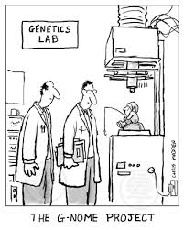
Human Genome Project:
Heredity is controlled by DNA
Genetic Diseases effect 8% humans
Started 1998 → Map 3 billion base pairs
Finished 2001!
Results:
Codes for 23,000 enzymes but potentially could
code for 100,000+ (junk DNA)
98% of Genome ≠ code proteins
Unknown or no function
Junk DNA
Regulation
Unused/Abandoned genes
1000 of genetic tests developed
Goal:
Cure Genetic Diseases – easier said than done, but some successes

Slide 39
Genetic Engineering

Slide 40
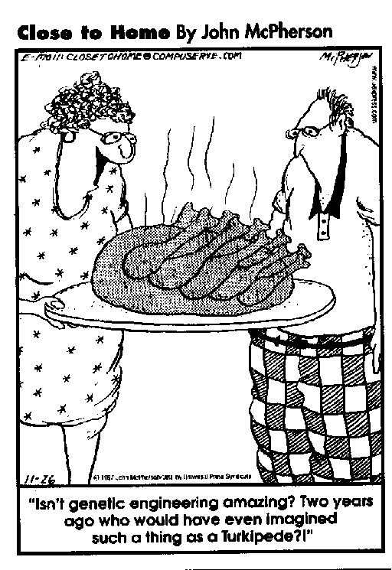
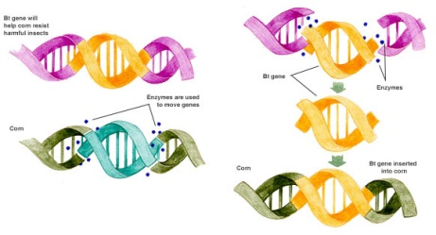
Genetic Engineering
Laboratory technique for controlling/causing genetic change
DNA polymerase chain reaction: copies specific genes over and over
Restriction Endonucleases: split DNA at very specific points
Insertion: Ability to insert genetic material
Ligases: covalently bond DNA back together
Recombinant DNA: DNA whose base pairs have been rearranged to contain new information
Examples:
Yeast/Bacteria → Insulin, Anemia drugs, Interferon
Agriculture → GMO crops, pesticide resistance

Slide 41
Mutation

Slide 42
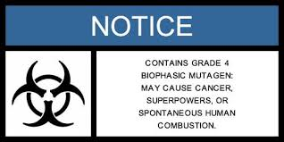
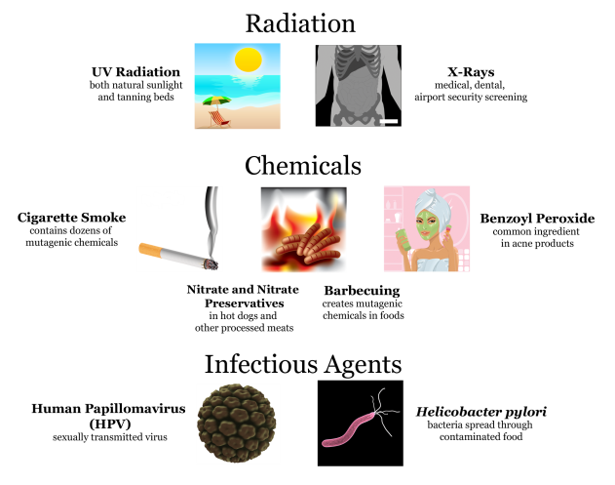
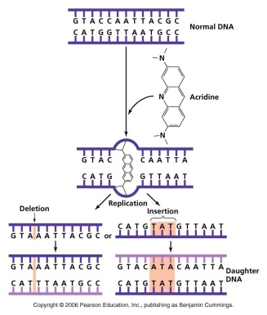
Mutation
Mutation: alteration to DNA that changes genome in child but not parent
Good (Superpowers) or Bad (Cancer, diseases)
Evolution
Mutagens: cause genetic damage
Ionizing Radiation – UV, x-rays, cosmic rays
Chemicals
Radioactive decay
Heavy Metals
Viruses
Anti-oxidants
Examples:
Cancer
Superpowers
Evolution

Slide 43
Translation
General (I)

Slide 44
Translation – General
Dfn: Biosynthesis of Proteins (DNA → RNA → Protein)
Step 0: Preparation
Step 1: Initialization
Step 2: Elongation
Step 3: Termination
Know the roles of:
DNA
mRNA, tRNA, rRNA
Ribosomes – 2 subunits, 3 binding sites (1 mRNA, 2-tRNA)
AA
ATP

Slide 45
Translation
General (II)

Slide 46
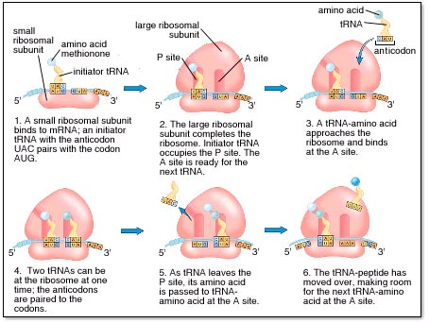

Slide 47
Translation
Step 0 - Preparation

Slide 48
Translation – Step 0 – Preparation
DNA transcribed to mRNA
mRNA moves from nucleous to cytoplasm
mRNA binds to 5+ ribosomes
tRNA binds to AA (requires an enzyme)
AA + tRNA + ATP → AA-tRNA + AMP + 2 P_{i}

Slide 49
Translation
Step 1 - Initiation

Slide 50
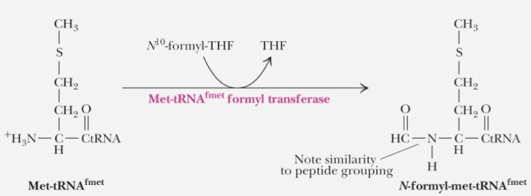
Translation – Step 1 – Initiation
AUG (Met) = start codon
Capped to prevent reaction on amine end
Ribosome binds to mRNA at/near the initiator/start codon

Slide 51
Translation
Step 2 - Elongation

Slide 52
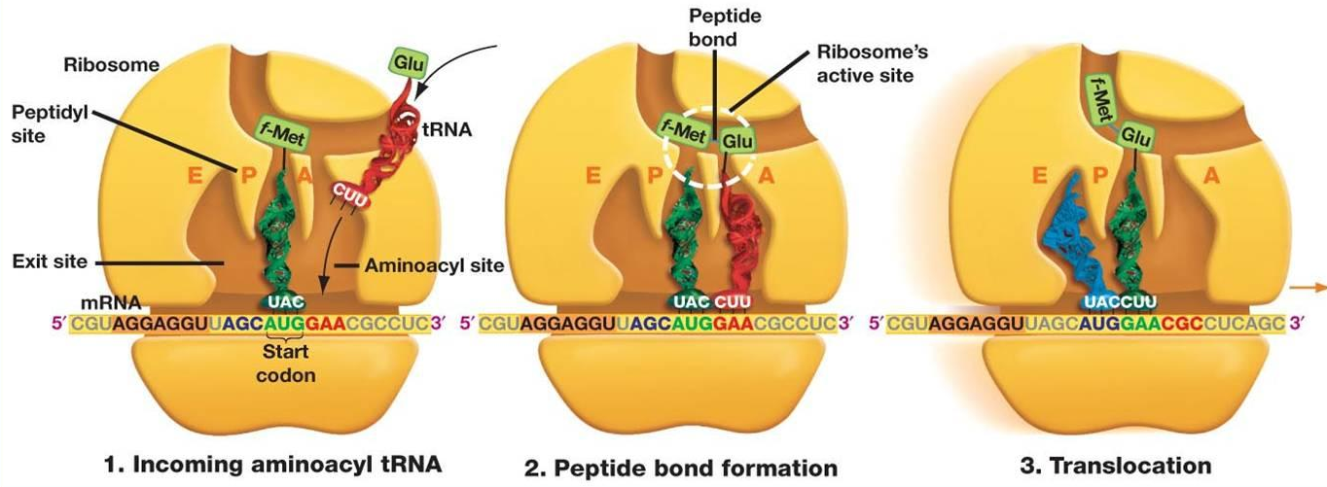
Translation – Step 2 – Elongation
tRNA HB to mRNA anticodon
Ribosome makes peptide bond between AA
tRNA breaks off (to be reused)
Process repeats….

Slide 53
Translation
Step 3 - Termination

Slide 54
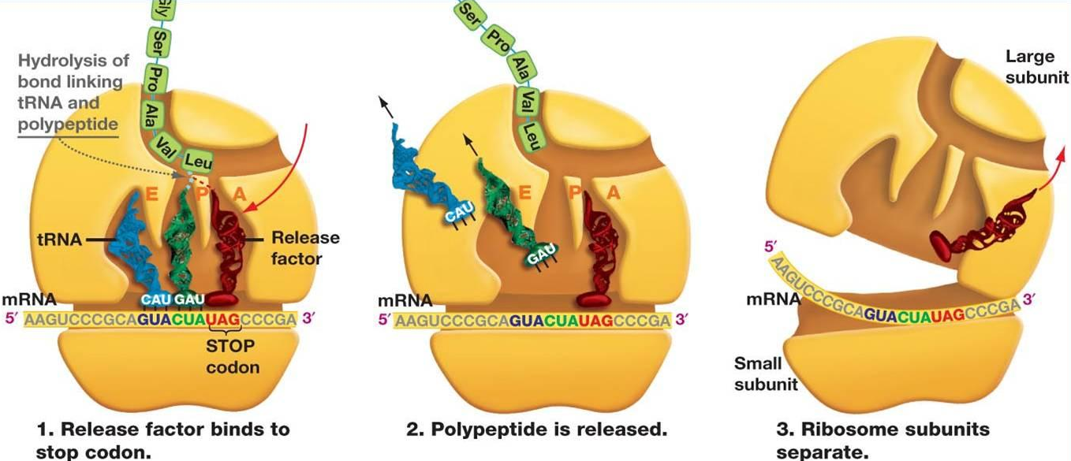
Translation – Step 3 – Termination
Elongation stops when a TC/nonsense codon is reached
Last tRNA is hydrolyzed
Ribosomes separate and release mRNA and finished protein

Slide 55
Big Picture:
Central Dogma
of Biology

Slide 57
Hydrogen Bonding

Slide 58
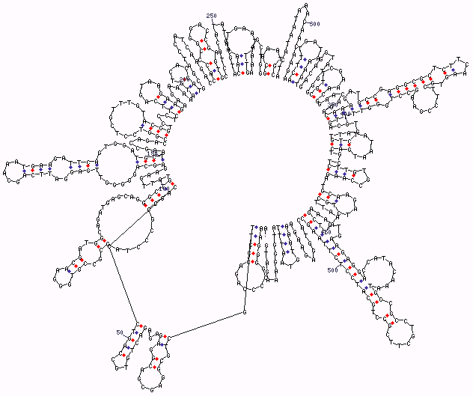
Hydrogen Bonding:
Complementary - Between Base Pairs
in DNA or DNA/RNA
Structure → specific shapes
of proteins and RNA

