Slide 1
Enzymes
General
Enzymes:
Proteins that catalyze biochemical reactions
Eduard Buchner (1907) – Nobel prize – living cells not
required for enzymes to function
Accelerate chemical reactions 1-100 million times
Enzyme Specificity
Functionality is very specific (1 Enzyme catalyzes 1 Reaction)
“-ase” ending
4 Common Features
Speed up reactions
Enzyme not altered in the reaction (reusable)
Highly specific
Reversible – One direction usually highly favored

Slide 2
Terms
Apoenzyme: protein part
Coenzyme: non-protein part
Holoenzyme: enzyme requiring Apo + Co to function
Activator: Inorganic part (metal ions)
Substrate: substance acted on by enzyme
Holoenzyme = apoenzyme + coenzyme

Slide 3
6 Classes of
Enzymes
6 Main Classes of Enzymes
Class | Function
Oxidoreductases | Oxidation-Reduction reactions between 2 substrates
2. Transferases | Transfer of functional group between 2 substrates
3. Hydrolases | Hydrolysis of esters, carbohydrates and proteins
4. Lysases | Removal of functional groups (not by hydrolysis)
5. Isomerases | Interconversion of stereoisomers and structural isomers
6. Ligases | Linkage of 2 compounds via breaking a phosphate anhydride bond in ATP

Slide 4
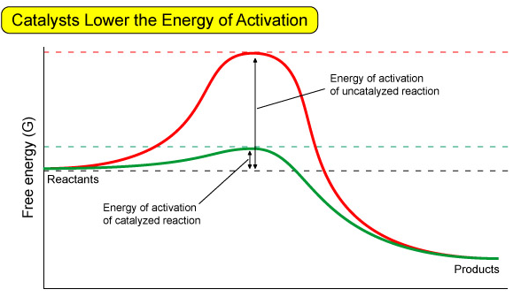
Reaction-Energy
Diagram
Transition State

Slide 5
Reaction-Energy
Terms
Activation Energy (Barrier):
Energy required for a reaction to occur
The larger the barrier the slower the rate
Transition State:
Unstable intermediate state ½ way between reactants and products
Catalysts work by altering the TS

Slide 6
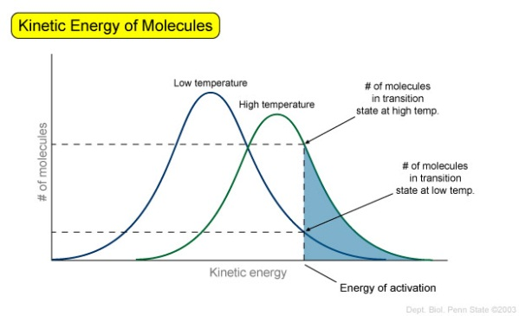
Increasing
Reaction
Rates
3 Ways to Increase Reaction Rates
Method | Description
Increase Reactant concentration | Increases number of molecules with enough energy to be able to react
Increase Reaction Temperature | Increases number of energy of all molecules therefore increasing the number with E > AE
3. Catalysts | Changes AE, allowing more molecules to react

Slide 7
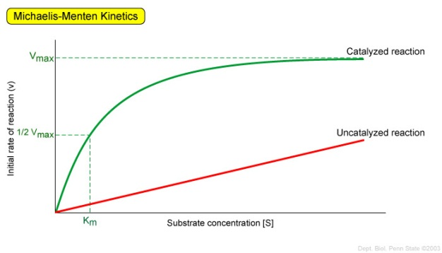
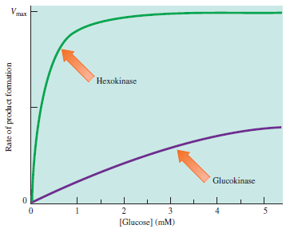
Enzyme Kinetics
Michaelis-Menton Plots:
Reaction Rate increases with increasing number of reactant molecules
Enzymes tailored to meet specific metabolic needs
Enzyme Catalyzed = Maximum rate limited
by number of catalyst
molecules
Unanalyzed = linear response
Level of substrate concentration
○ Hexokinase = low [conc] = energy
○ Glucokinase = high [conc] = storage
Rate of reaction (turnover number)
○ Catalase = fast – destroys toxins
○ Chrymotrypsin = slow - digestion

Slide 8
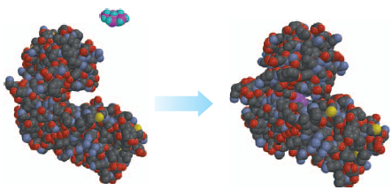
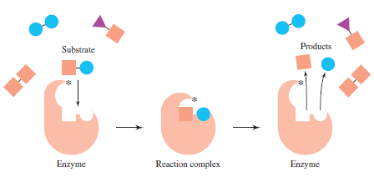
Enzyme Active
Site
Enzyme Active Site:
Area where catalysis occurs
Small (1-5%) of total surface area
Very Specific: 1 enzyme = 1 reaction (Specificity)

Slide 9
Lock-and-Key Hypothesis
and
Induced-Fit Model
Lock-and-Key Hypothesis:
Substrate (Key) fits into the Enzyme (Lock)
One key, One lock
Flaw: not rigid → Induced
Fit Model
Induced-Fit Model:
Active site is flexible
Enzyme can change state to bind/catalyze a reaction
Only this key
fits in the lock
Lock

Slide 10
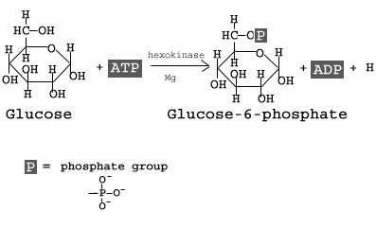
Proximity Catalysis
and
Productive Binding
Proximity Catalysis:
Enzyme holds the reactants in close proximity
Productive Binding:
Enzyme holds reactants in proper orientation for reaction to occur
Example: Glucose → Glucose-6-Phosphate
Many parts required (Substrate + ATP + Mg⁺² ion. (Proximity Catalysis)
Phosphate only added to #6 carbon (Productive Binding)

Slide 11
Temperature
Effect of Temperature on Catalysts:
Any change that effects protein structure effects an enzymes catalytic ability
Low Temp = Few molecules have AE required to react (+ denaturation)
High Temp = Enzymes denature

Slide 12
pH
Effect of pH on Catalysts:
Any change that effects protein structure effects an enzymes catalytic ability
Charge of –COOH and –NH₂ effected by pH → change in 2°/3°/4° structure

Slide 13
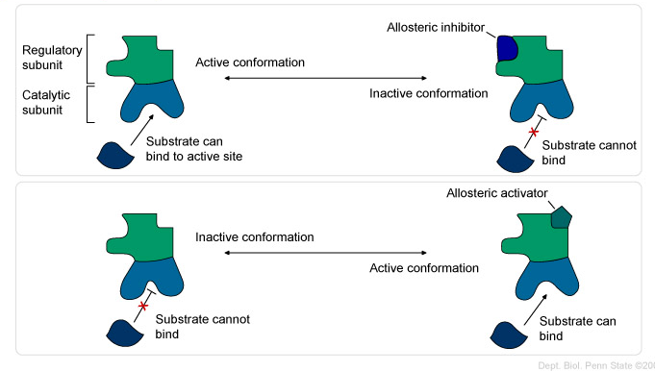
Enzyme Regulation
Allosteric Regulation:
Active domain – catalyzes the reaction
Regulatory domain – modulates activity
Activator/inhibitors bind to Regulatory domain and change the catalytic ability of enzyme
Covalent Modification:
Functional groups bonded to enzyme
Ex: Phosphorylation

Slide 14
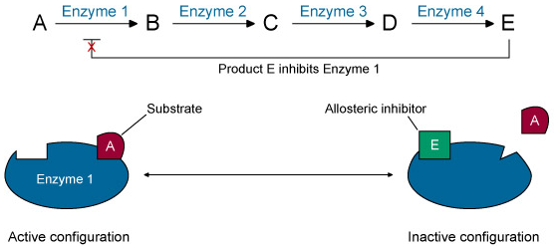
Feedback Inhibition
Feedforward Activation
Feedforward Activation
Excess of beginning R/P increases the reaction rate of a later step
Feedback Inhibition
Excess of final product decreases the reaction rate of an earlier step

