Slide 1
Amino Acids
General
Amino Acids:
Building blocks for peptides, proteins
Some individually important (or converted to important molecules)
Gly, Glu, Tyr → neurotransmitters
Tyr → parent/precursor for epinephrine (adrenaline)
His → stomach secretes HCl, symptoms for inflammation, colds.
Essential (10)
needed for normal health
not synthesized by the body
must be supplied by diet
Complete (animal) vs. Incomplete (vegetable) protein

Slide 2
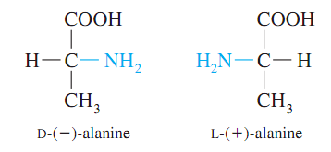
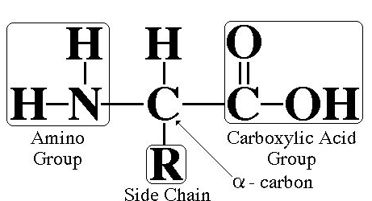
Amino Acids
Structure
Amino Acid Structure:
Amide, CA, R-group (variable)
D/L Isomers

Slide 3
Amino Acids
Side Chains
AA – Side Chains:
Side chains determine the functionality of the AA b/c the –COOH and –NH₂
groups react to form the backbone
3 letter abbreviations (given on cheat sheet)
Classification | Functional Group | Property
Nonpolar | -R (aliphatic or aromatic) | Hydrophobic
Polar | -COOH, -NH₂, -OH | Hydrophilic
Acidic | -COOH (extra) | Lose H₂ → anion → Salt Bridges
Basic | -NH₂ (extra) | Gain H₂ → cation → Salt Bridges

Slide 4
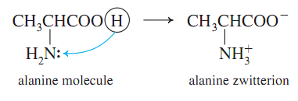
Zwitterion
Zwitterion: dipolar form of AA, found at biological pH’s (internal acid/base Rxn)

Slide 5
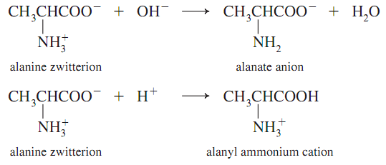
Amphoteric
Amphoteric: molecules with properties of both acid and base

Slide 6
Formation of
Polypeptides
Formation Reaction:
Dehydration reaction
CA + Amine → Amide
Amide structure/Peptide bond/Peptide linkage

Slide 7
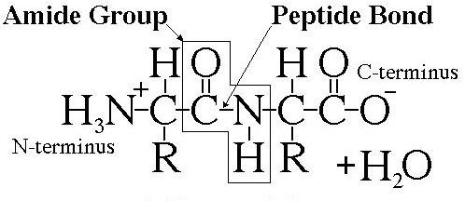
Amide/Peptide
Bonds

Slide 8
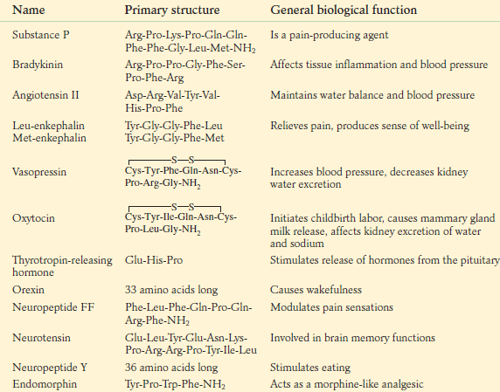
Polypeptides
Polypeptides:
Small chains of AA (40-50 units)
Many ways to connect together (N!)
~30 biologically relevant ones
Hormones or Nerve transmitters
Small changes structure → HUGE changes in functionality

Slide 9
Protein
Structure
Proteins – General:
> 50 AA
Linus Pauling – 1954 Nobel Prize → α-helix and β-pleated sheet
Fredrick Sanger – 1958 → Primary structure of beef insulin
Classification | Description | Examples
Primary | #, kind, type and sequence of AA
Secondary | Regular 3D structure, held together by H-bonds in backbone | α-helix β-pleated sheet triple helix
Tertiary | Distinct 3D structure due to interactions between R-groups | H-bonds Ionic bonds (Salt Bridges) Disulfide bonds Hydrophobic Hydrophilic
Quaternary | Complex proteins | Multiple units Non-protein parts Metal ions

Slide 10
Primary Structure
Primary Structure:
#, kind, type, and sequence of AA
Fredrick Sanger (1958 Nobel Prize) Beef Insulin
Several years of work to sequence 51 AA
Hydrolyzed proteins into smaller fragments to analyze
Edman Degradation – split AA at N-Terminal End
Fragment 1:
Gly-Glu-Arg-Gly-Phe-Phe-
Fragment 2:
Gly-Phe-Phe-Tyr-Thr-Pro-Lys
Combined:
Gly-Glu-Arg-Gly-Phe-Phe-Tyr-Thr-Pro-Lys
Overlap

Slide 11
Secondary Structure
Secondary Structure:
Determined by H-bonds between AA-backbone
α-helix → AA 4 residues apart, R-groups towards outside
β-pleated sheet → AA far apart, R-groups face outwards

Slide 12
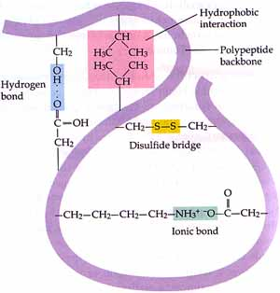
Tertiary Structure
Tertiary Structure:
Determined by interactions between R-groups
H-bonds: -COOH and –OH
Ionic/Salt Bridges
Disulfide Bonds
Hydrophobic (form core of protein)
Hydrophilic (face outwards to interact with water)

Slide 13
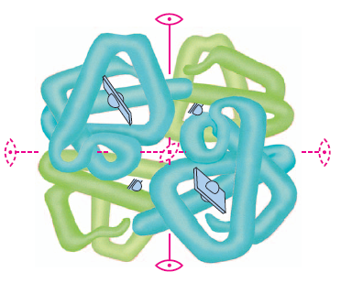
Quaternary Structure
Quaternary Structure:
Multiple protein units
Non-protein parts
Metal ions
Ex: Hemoglobin
4 subunits
Fe atoms

Slide 14
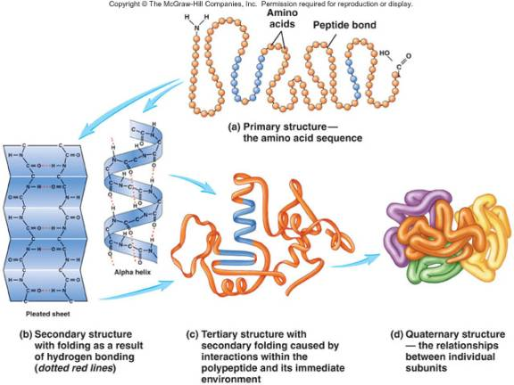
Protein Structure
Summary

Slide 15
α-Helix
α-helix Structure:
Secondary
Determined by H-bonds between AA-backbone
α-helix → AA 4 residues apart, R-groups towards outside

Slide 16
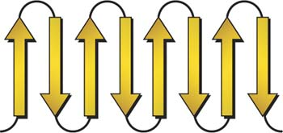
β-Pleated Sheet
β-pleated sheet structure:
Secondary
Determined by H-bonds between AA-backbone
β-pleated sheet → AA far apart, R-groups face outwards

Slide 17
H-bonds
Secondary H-bonds:
Between the C=O and NH of backbone
Responsible for secondary structure
Tertiary H-bonds:
Between the C=O and -NH or -OH of R-groups
Responsible for tertiary structure

Slide 18
Salt Bridges
Ionic Bonds/Salt Bridges:
Tertiary Structure
Between –COO⁻ and –NH3⁺ groups

Slide 19
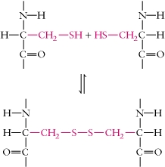
Disulfide Bonds
Disulfide bonds:
Tertiary Structure
Between -SH and –SH groups
Mainly between Cys-Cys

Slide 20
Hydrophobic
Interactions
Hydrophobic Interactions:
Tertiary Structure
Between –R groups (Alkane and Aromatic)
Interior of proteins to avoid water

Slide 21
Hydrophilic
Interactions
Hydrophilic Interactions:
Tertiary Structure
Exterior of proteins to interact with water
Polar groups (OH)
Acidic groups (COOH)
Basic groups (NH₂)

Slide 22
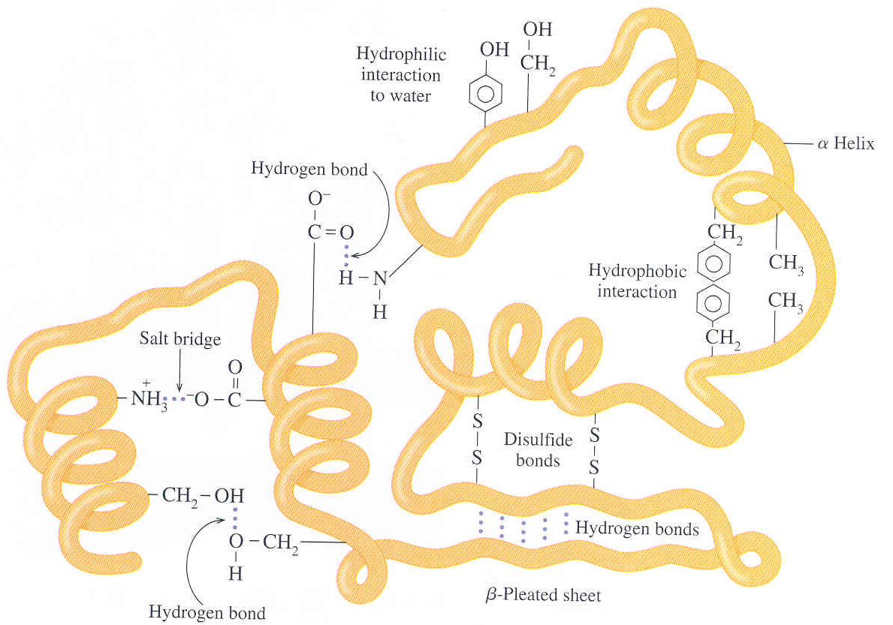
Identify 2°/3°
Structure

Slide 23
Protein Functions
Protein Functions:
Structural Support – skin, connective tissue
Storage – Fe in Liver
Transport – O₂ in Hemoglobin
Defense – antibodies, venom
Motion/Movement – muscles
Regulation – blood/glucose/insulin
Catalysis – Enzymes (Ch. 30!)

Slide 24
Denaturation
Denaturation: Loss of 3D conformation in a protein
Disruption of 2°/3°/4° interactions
Does NOT break 1° structure (hydrolysis)
Loss of biological activity
Causes of Denaturation
 | Cause | Example
1. | Heat | Cooking
2. | Acids/Base (pH) | Lactic Acid
3. | Organic Molecules | Ethanol/Isopropanol
4. | Heavy Metals | Pb, Hg
5. | Agitation | Stirring
6. | UV Light
7. | Enzymes | Digestion
8. | Salts | Water purification

Slide 25
Xanthoproteic
Test
Xanthoproteic Test:
Detects Benzene rings
Yellow color
Phe, Try, Tyr

Slide 26
Biuret
Test
Biuret Test:
Detects tri-peptides (must have at least 2 peptide bonds)
Cu₂SO₄
Violet color

Slide 27
Ninhydrin
Test
Ninhydrin Test:
General test for AA
All AA → blue
Pro, hydroxyproline → yellow
Very sensitive 1 μg (10⁻⁶)

Slide 28
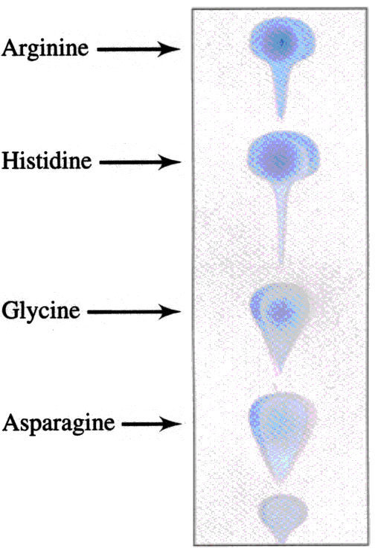
Chromatography
Chromatography: separation technique for AA
Difference in distribution between two phases
○ Solubility
○ Charge
TLC (thin-layer) – solid/liquid phase
○ Solvent Front (rate solvent moves)
○ Differences in solubility cause AA to
travel at different rates in the solvent
Column chromatography (variation of above)

Slide 29
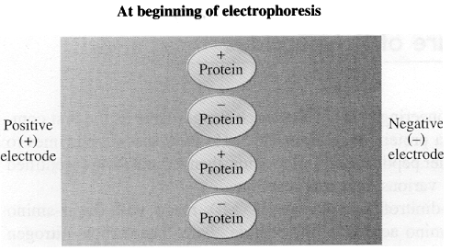
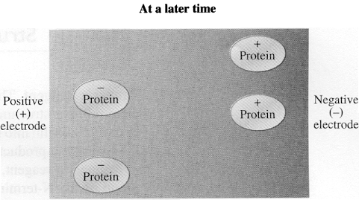
Electrophoresis
Electrophoresis: separation technique for AA
Charged particles separate in electric field (zwitterions)
Separation based on
○ Size – friction (sieve)
○ Charge – electric field
Types
○ SDS – masks charge/separate by mass/size
○ Isoelectric Focusing – AA separated by charge
○ 2D – separate on both.

Slide 30
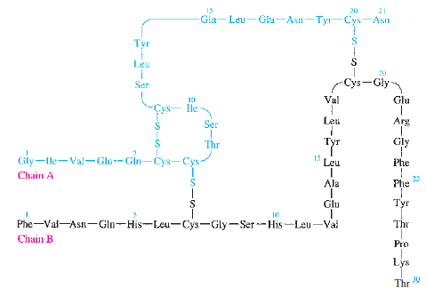
Fredrick Sanger
Fredrick Sanger:
Solved structure of beef insulin (1955)
Nobel prize 1958
51 AA in two chains held together by disulfide bonds
DFNB + N-terminal end + hydrolysis to solve structure
“Paper shredder”

