Slide 1
Number of
Carbohydrate Units
Monosaccharides = single unit
Disaccharides = two units
Oligiosaccharide = 3-10 units
Polysaccharide = 11+ units
Bonus:
Can you name the most common Mono (4), Di(3), and Poly(4)-saccharides

Slide 2
Number of Carbons
3C = Triose
4C = Tetrose
5C = Pentose
6C = Hexose
7C = Heptose
Most common are 5 and 6 Carbon Carbohydrate
Bonus:
Can you name the most common pentose?
Can you name the most common hexoses?

Slide 3
Functional Group
Aldose = aldehyde
Ketose = ketone
Bonus:
Can you name a common example of each?

Slide 4
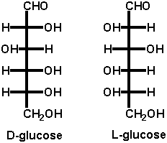
D or L Isomer
The orientation of the OH group furthest from the most
oxidized end of a carbohydrate.
The bottom OH on a properly drawn Fischer Projection

Slide 5
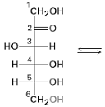
Size of Ring
Furanose = 5 member ring - Ald/Ket + OH 4 carbons a way
Pyranose = 6 member ring - Ald/Ket + OH 5 carbons away

Slide 6
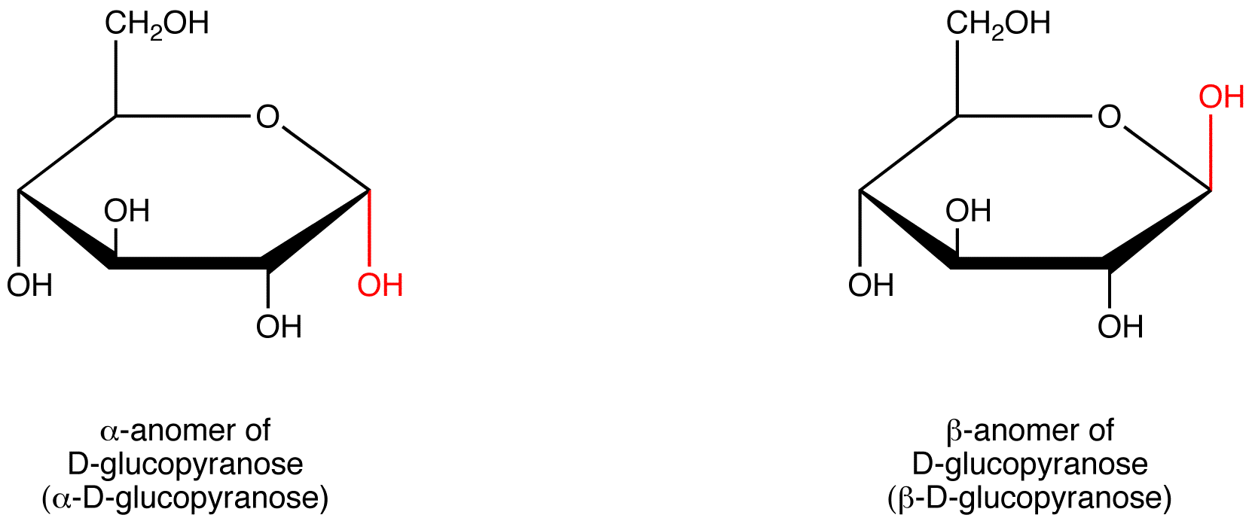
Anomers
Definition:
Diastereomers that differ in the configuration/orientation around the
OH group on the carbon capable of mutarotation
(hemiacetal or hemiketal carbon)
BUDA (Beta Up, Down Alpha)
Beta - Up
Down - Alpha

Slide 7
Epimers
Definition:
Two monosaccharide's that differ in the configuration around a single carbon.
D-allose
D-altrose
D-glucose
D-gulose
L-talose

Slide 8
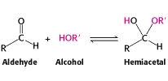
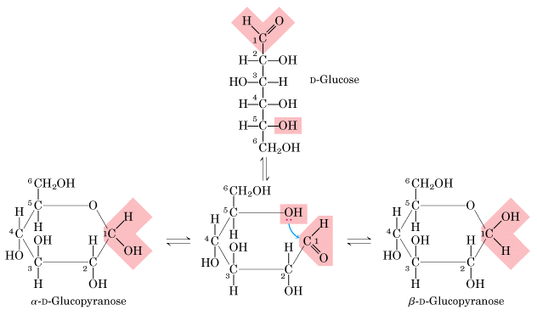
Drawing Pyranose Rings
Number the chain to decrease mistakes
Left OH’s Up
Right OH’s Down
#6 - CH₂OH group up for D-isomers
Hemiacetal reaction
#1/5 Carbons
React
R-side OH
are down
L-side OH
are up

Slide 9
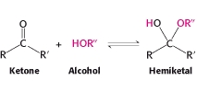
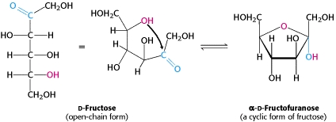
Drawing Furanose Rings
#2/5 Carbons
React
L-side OH
are up
R-side OH
are down

Slide 10
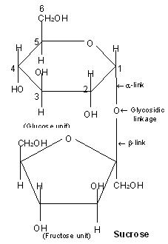
Drawing Disaccharides
Formed by a dehydration reaction
Draw a disaccharide given two monosaccharide's and the linkage
Name disaccharides
First ring (yl ending), Second normal
“Sucrose”
α-D-glucopyranosyl-(1,2)-
β-D-fructofuranose
“Lactose”
β -D-galactopyranosyl-(1,4)-α-D-glucopyranose

Slide 11
Hemiacetals, Acetals,
Hemiketals, and Ketals
Hemiacetals and Hemiketals
Capable of mutarotation
React easily
Reducing sugars
Acetals and Ketals
Not Capable of mutarotation
Not Reactive (hydrolysis)
Not Reducing sugars

Slide 12
Monosaccharides
 | 4 Most Common Monosaccharide's
Structural Isomers | D-Glucose | aldohexose | pyranose | bloodsugar, cellular respiration
 | D-Galactose | aldohexose | pyranose | milk, yogurt, cell membranes
 | D-Fructose | ketohexose | furanose | honey, sweetest sugar
 | D-Ribose | aldopentose | furanose | DNA

Slide 13
Disaccharides
3 Most Common Disaccharides
Maltose | α-D-Glucose + α-D-Glucose | α-1,4 | beer, starch breakdown product
Lactose | β-D-Galactose + α-D-Glucose | β-1,4 | milk sugar
Sucrose | α-D-Glucose + β-D-Fructose | α-β-1,2 | table sugar

Slide 14
Polysaccharides
 | 4 Most Common Polysaccharide's
Starch | Amylose | α-1,4 | helix | plant energy storage
 | Amylopectin | α-1,4 (main) α-1,6 (side) | treelike | plant energy storage
 | Glycogen | similar to amylopectin | treelike | animal energy storage
 | Cellulose | β-1,4 | linear/ sheets | plant structural storage

Slide 15
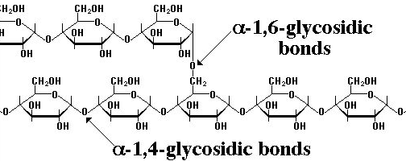
Starch
Amylose:
25-1300 α-D-Glucose units
α-1,4-glycosidic bonds
Forms coils/helical/telephone structure
Energy storage for plants
Amylopectin:
25-1300 α-D-Glucose units
α-1,4-glycosidic bonds, branched every 25
glucose with a α-1,6-glycosidic bond
Forms tree like structure
Energy storage for plants

Slide 16
Glycogen
Glycogen:
25-1300 α-D-Glucose units
α-1,4-glycosidic bonds, branched every 12-18
glucose with a α-1,6-glycosidic bond
Forms tree like structure
Similar to amylopectin, but more branched
Energy storage for animals

Slide 17
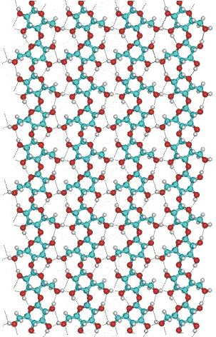
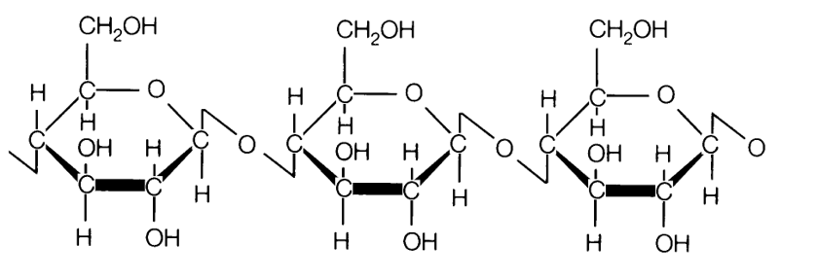
Cellulose
Cellulose:
25-1300 β-D-Glucose units
β-1,4-glycosidic bonds
Forms linear chains, strong H-bonds leads
to the formation of sheets
Resistant to hydrolysis, indigestible by humans
Most abundant organic substance in nature
Chief structural component of plants and wood
or

Slide 18
Mutarotation
Process by which anomers are interconverted
Equilibrium between cyclic and chain form.
Occurs because hemiacetal carbon can open/close

Slide 19
Oxidation Reactions
Mild Oxidation
Ald → CA
-“onic” acid
-“aric” acid
Strong Oxidation
Ald → CA
Alc → CA

Slide 20
Reduction Reaction
Reduction
Ald → Alc
-“itol” acid

Slide 21
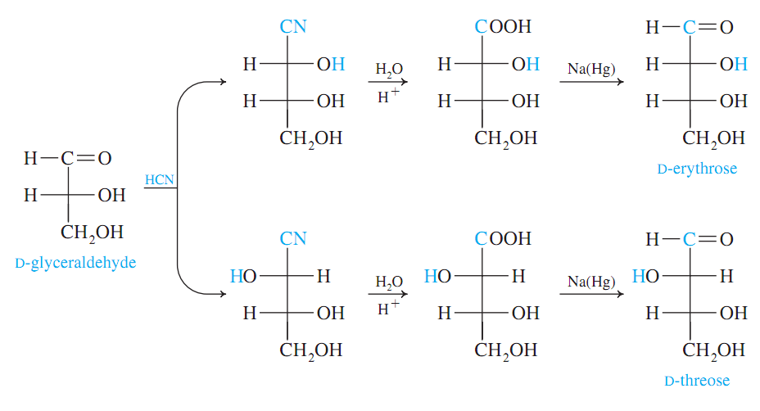
Kiliani-Fischer Reaction
Carbon Chain
Gains a Carbon
3C → 4C
Aldehyde
Cyanohydrin
Carboxylic Acid
Aldehyde
Cyanohydrin
Rxn
Hydrolysis
Rxn
Reduction
Rxn

Slide 22
Redox Tests
Redox Tests for Carbohydrates:
Benedicts/Fehling/ Barfoeds – Cu⁺² → Cu₂O (s) “Blue → Brick Red ppt
Tollens – Reduce Ag⁺ → Ag (s) “Silver Mirror”
Sugar is Oxidized, Metals are Reduced
general tests
mono/di
Functional Groups:
Free Aldehydes
α-hydroxyketones
Hemiacetal

Slide 23
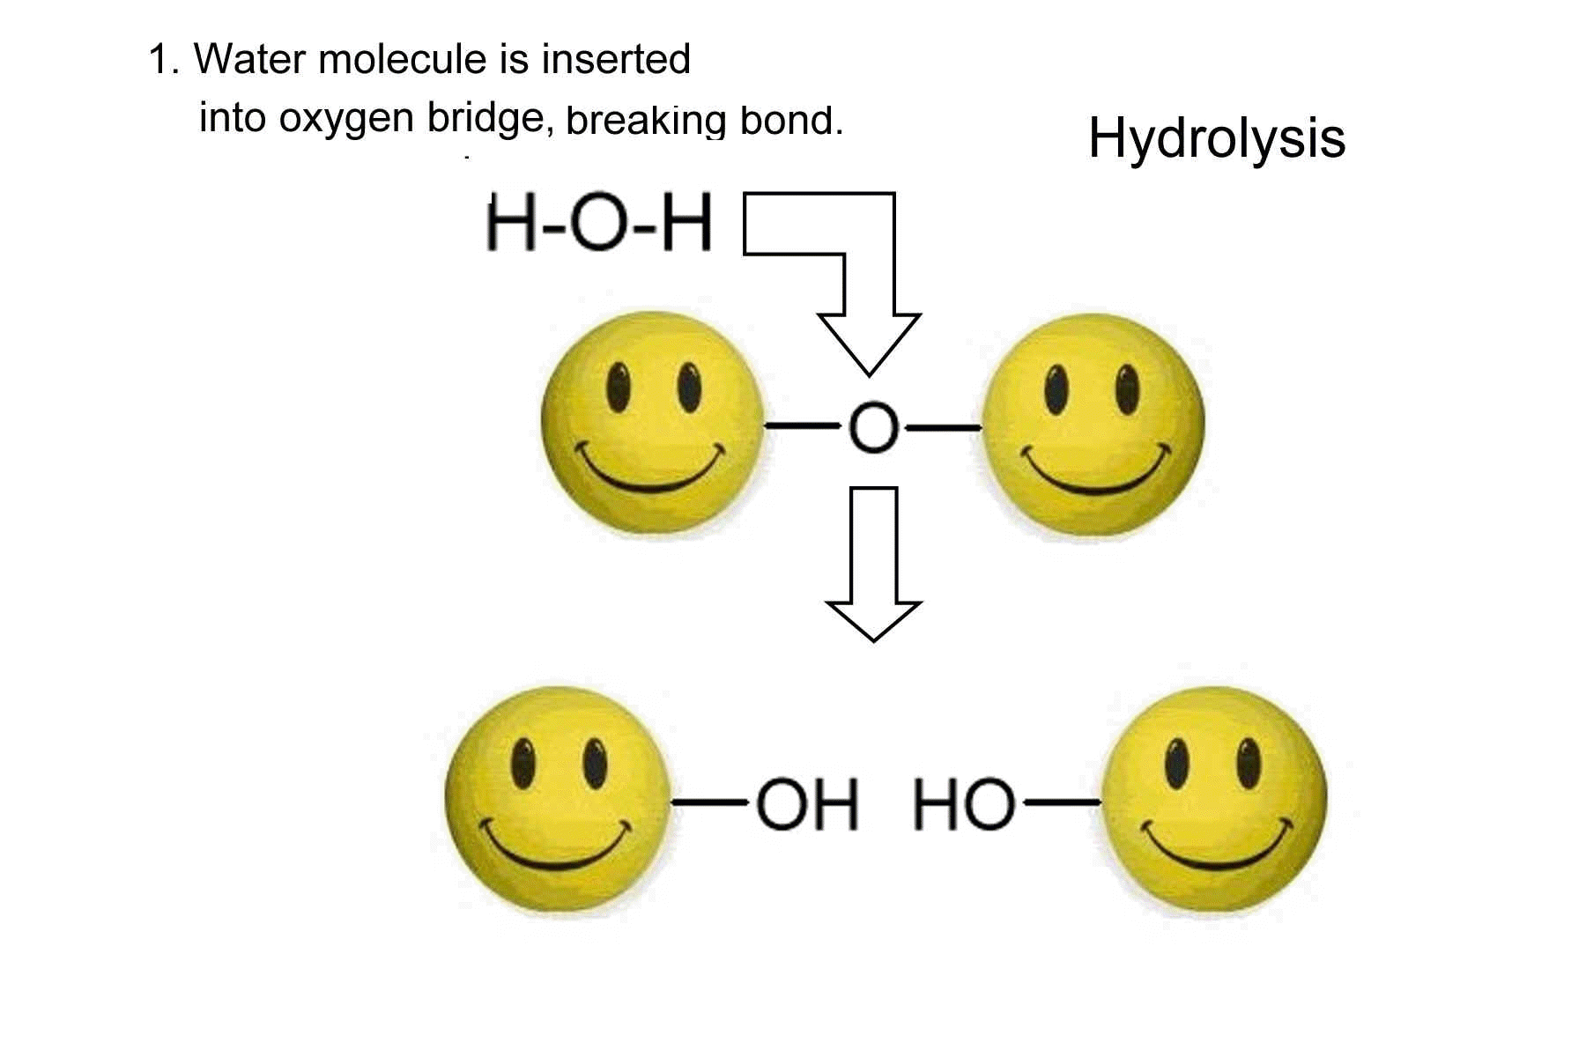
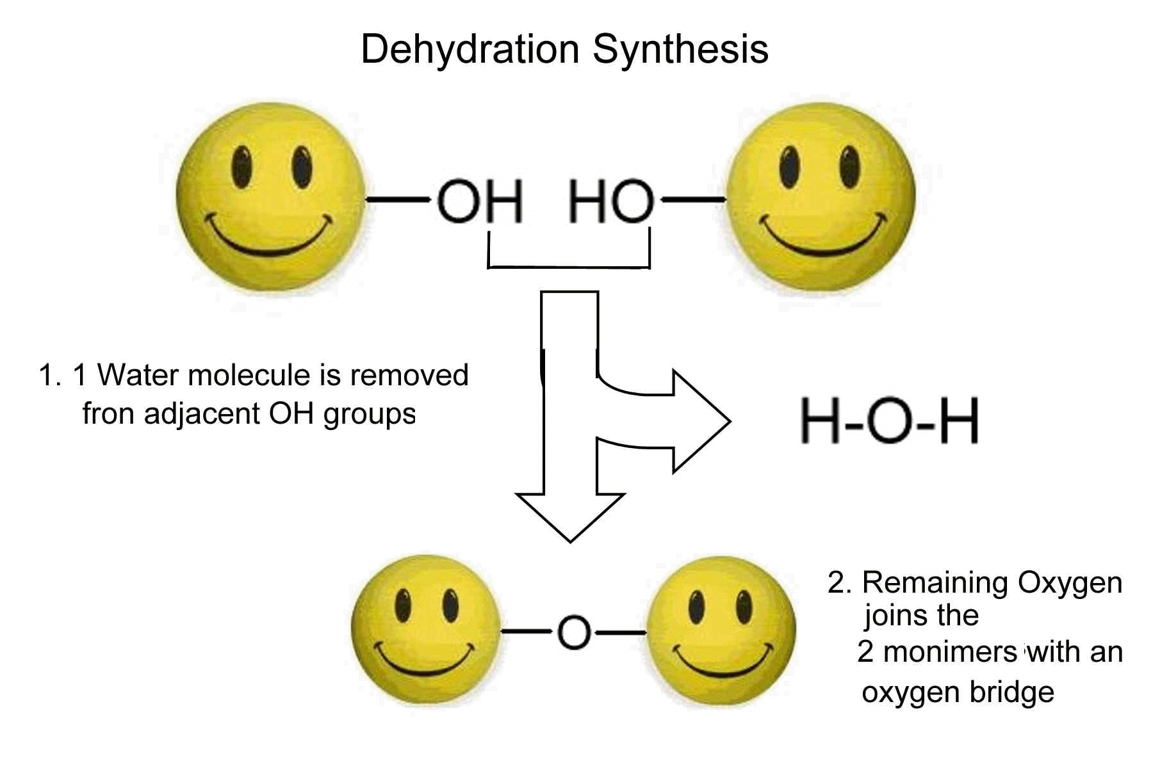
Dehydration/Hydrolysis
Carbohydrate molecules are joined by Dehydration Reactions (-H₂O)
Di/Oligio/Polysaccharides are broken apart by Hydrolysis Reactions (+H₂O)

Slide 24
Dehydration/Hydrolysis
Carbohydrate molecules are joined by Dehydration Reactions (-H₂O)
Di/Oligio/Polysaccharides are broken apart by Hydrolysis Reactions (+H₂O)

Slide 25
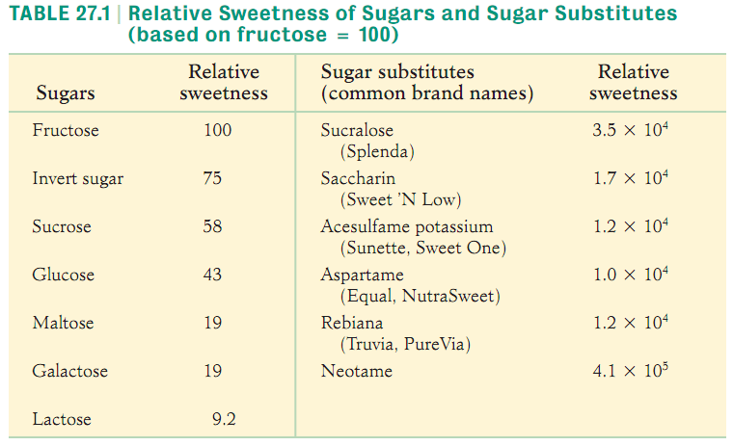
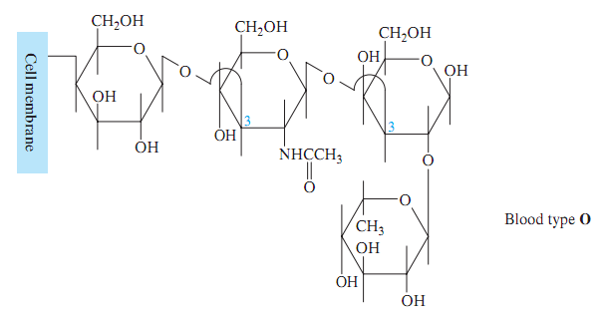
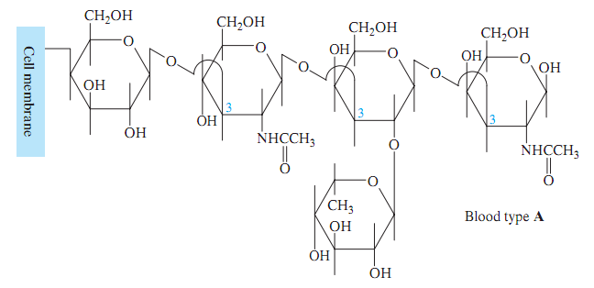
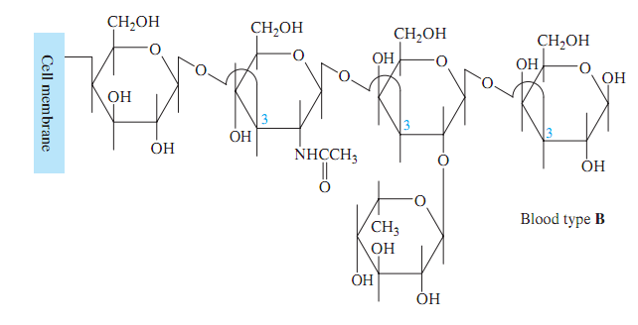
Miscellaneous
Applications
Sweeteners
Antigens / Blood Types

