Slide 1
Number of
Carbohydrate Units

Slide 2
Monosaccharides = single unit
Disaccharides = two units
Oligiosaccharide = 3-10 units
Polysaccharide = 11+ units
Bonus:
Can you name the most common Mono (4), Di(3), and Poly(4)-saccharides

Slide 3
Number of Carbons

Slide 4
3C = Triose
4C = Tetrose
5C = Pentose
6C = Hexose
7C = Heptose
Most common are 5 and 6 Carbon Carbohydrate
Bonus:
Can you name the most common pentose?
Can you name the most common hexoses?

Slide 5
Functional Group

Slide 6
Aldose = aldehyde
Ketose = ketone
Bonus:
Can you name a common example of each?

Slide 7
D or L Isomer

Slide 8
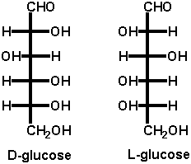
The orientation of the OH group furthest from the most
oxidized end of a carbohydrate.
The bottom OH on a properly drawn Fischer Projection

Slide 9
Size of Ring

Slide 10
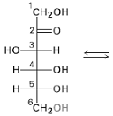
Furanose = 5 member ring - Ald/Ket + OH 4 carbons a way
Pyranose = 6 member ring - Ald/Ket + OH 5 carbons away

Slide 11
Anomers

Slide 12
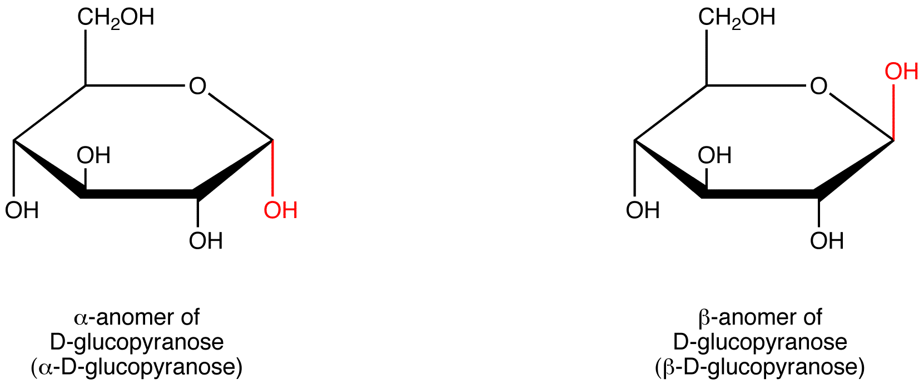
Definition:
Diastereomers that differ in the configuration/orientation around the
OH group on the carbon capable of mutarotation
(hemiacetal or hemiketal carbon)
BUDA (Beta Up, Down Alpha)
Beta - Up
Down - Alpha

Slide 13
Epimers

Slide 14
Definition:
Two monosaccharide's that differ in the configuration around a single carbon.
D-allose
D-altrose
D-glucose
D-gulose
L-talose

Slide 15
Drawing Pyranose Rings

Slide 16
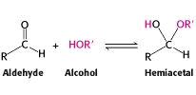
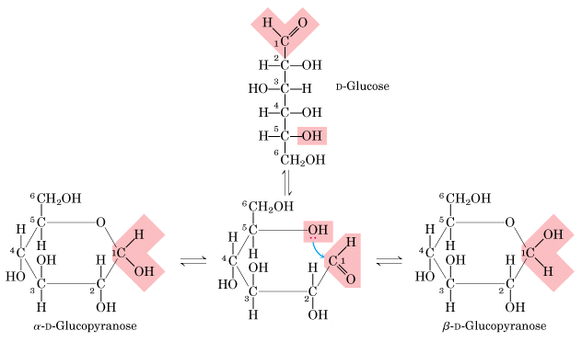
Number the chain to decrease mistakes
Left OH’s Up
Right OH’s Down
#6 - CH₂OH group up for D-isomers
Hemiacetal reaction
#1/5 Carbons
React
R-side OH
are down
L-side OH
are up

Slide 17
Drawing Furanose Rings

Slide 18
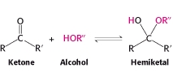
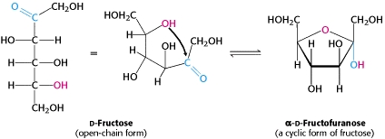
#2/5 Carbons
React
R-side OH
are down
L-side OH
are up

Slide 19
Drawing Disaccharides

Slide 20
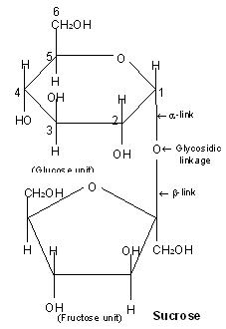
Formed by a dehydration reaction
Draw a disaccharide given two monosaccharide's and the linkage
Name disaccharides
First ring (yl ending), Second normal
“Sucrose”
α-D-glucopyranosyl-(1,2)-
β-D-fructofuranose
“Lactose”
β -D-galactopyranosyl-(1,4)-α-D-glucopyranose

Slide 21
Hemiacetals, Acetals,
Hemiketals, and Ketals

Slide 22
Hemiacetals and Hemiketals
Capable of mutarotation
React easily
Reducing sugars
Acetals and Ketals
Not Capable of mutarotation
Not Reactive (hydrolysis)
Not Reducing sugars

Slide 23
Monosaccharide’s

Slide 24
 | 4 Most Common Monosaccharide's
Structural Isomers | D-Glucose | aldohexose | pyranose | bloodsugar, cellular respiration
 | D-Galactose | aldohexose | pyranose | milk, yogurt, cell membranes
 | D-Fructose | ketohexose | furanose | honey, sweetest sugar
 | D-Ribose | aldopentose | furanose | DNA

Slide 25
Disaccharides

Slide 26
3 Most Common Disaccharides
Maltose | α-D-Glucose + α-D-Glucose | α-1,4 | beer, starch breakdown product
Lactose | β-D-Galactose + α-D-Glucose | β-1,4 | milk sugar
Sucrose | α-D-Glucose + β-D-Fructose | α-β-1,2 | table sugar

Slide 27
Polysaccharides

Slide 28
 | 4 Most Common Polysaccharide's
Starch | Amylose | α-1,4 | helix | plant energy storage
 | Amylopectin | α-1,4 (main) α-1,6 (side) | treelike | plant energy storage
 | Glycogen | similar to amylopectin | treelike | animal energy storage
 | Cellulose | β-1,4 | linear/ sheets | plant structural storage

Slide 29
Starch

Slide 30
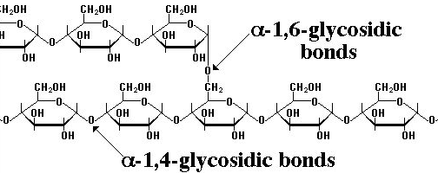
Amylose:
25-1300 α-D-Glucose units
α-1,4-glycosidic bonds
Forms coils/helical/telephone structure
Energy storage for plants
Amylopectin:
25-1300 α-D-Glucose units
α-1,4-glycosidic bonds, branched every 25
glucose with a α-1,6-glycosidic bond
Forms tree like structure
Energy storage for plants

Slide 31
Glycogen

Slide 32
Glycogen:
25-1300 α-D-Glucose units
α-1,4-glycosidic bonds, branched every 12-18
glucose with a α-1,6-glycosidic bond
Forms tree like structure
Similar to amylopectin, but more branched
Energy storage for animals

Slide 33
Cellulose

Slide 34
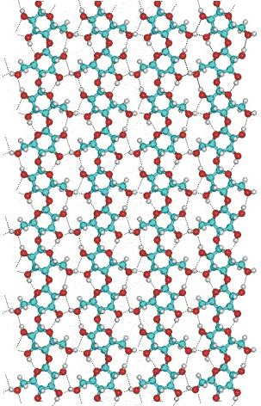
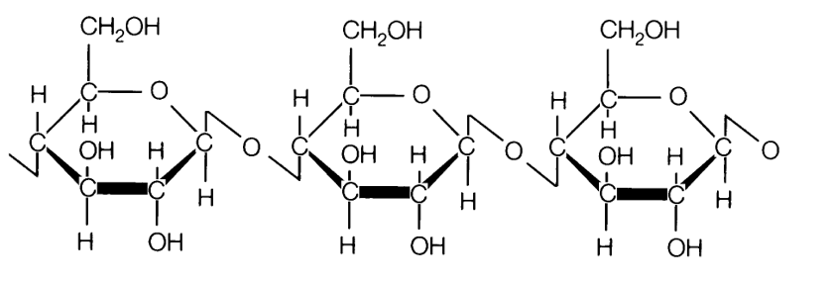
Cellulose:
25-1300 β-D-Glucose units
β-1,4-glycosidic bonds
Forms linear chains, strong H-bonds leads
to the formation of sheets
Resistant to hydrolysis, indigestible by humans
Most abundant organic substance in nature
Chief structural component of plants and wood
or

Slide 35
Mutarotation

Slide 36
Process by which anomer’s are interconverted
Equilibrium between cyclic and chain form.
Occurs because hemiacetal carbon can open/close

Slide 37
Oxidation Reactions

Slide 38
Mild Oxidation
Ald → CA
-“onic” acid
-“aric” acid
Strong Oxidation
Ald → CA
Alc → CA

Slide 39
Reduction Reaction

Slide 40
Reduction
Ald → Alc
-“itol” acid

Slide 41
Kiliani-Fischer Reaction

Slide 42
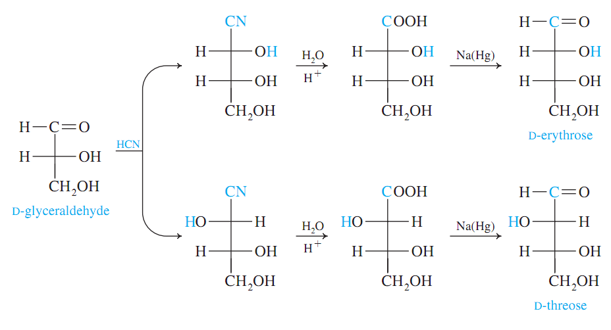
Carbon Chain
Gains a Carbon
3C → 4C
Aldehyde
Cyanohydrin
Carboxylic Acid
Aldehyde
Cyanohydrin
Rxn
Hydrolysis
Rxn
Reduction
Rxn

Slide 43
Redox Tests

Slide 44
Redox Tests for Carbohydrates:
Benedicts/Fehling/ Barfoeds – Cu⁺² → Cu₂O (s) “Blue → Brick Red ppt
Tollens – Reduce Ag⁺ → Ag (s) “Silver Mirror”
Sugar is Oxidized, Metals are Reduced
general tests
mono/di
Functional Groups:
Free Aldehydes
α-hydroxyketones
Hemiacetal

Slide 45
Dehydration/Hydrolysis

Slide 46
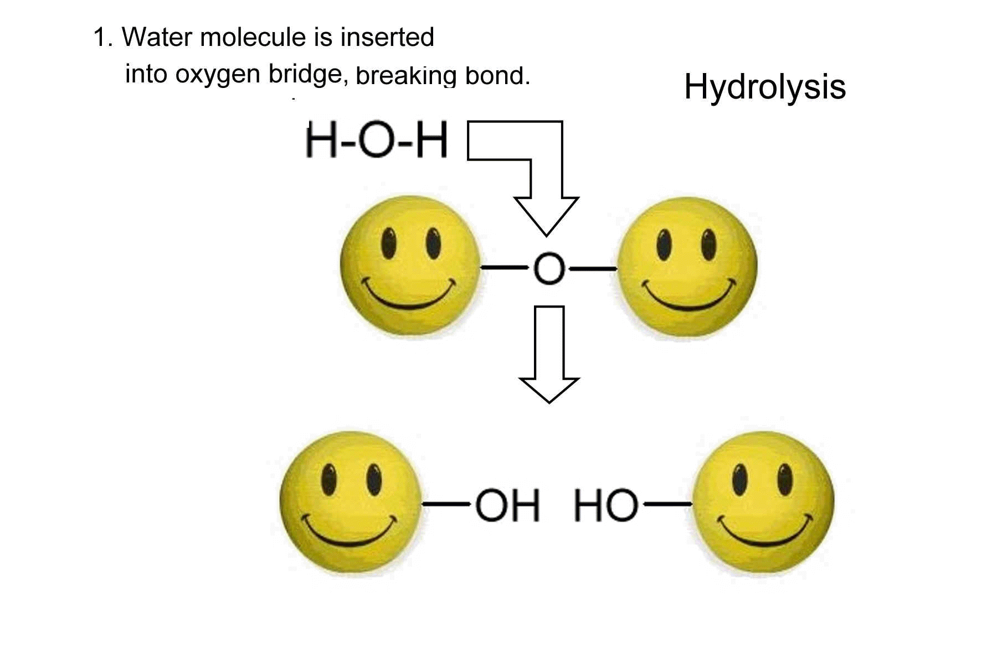
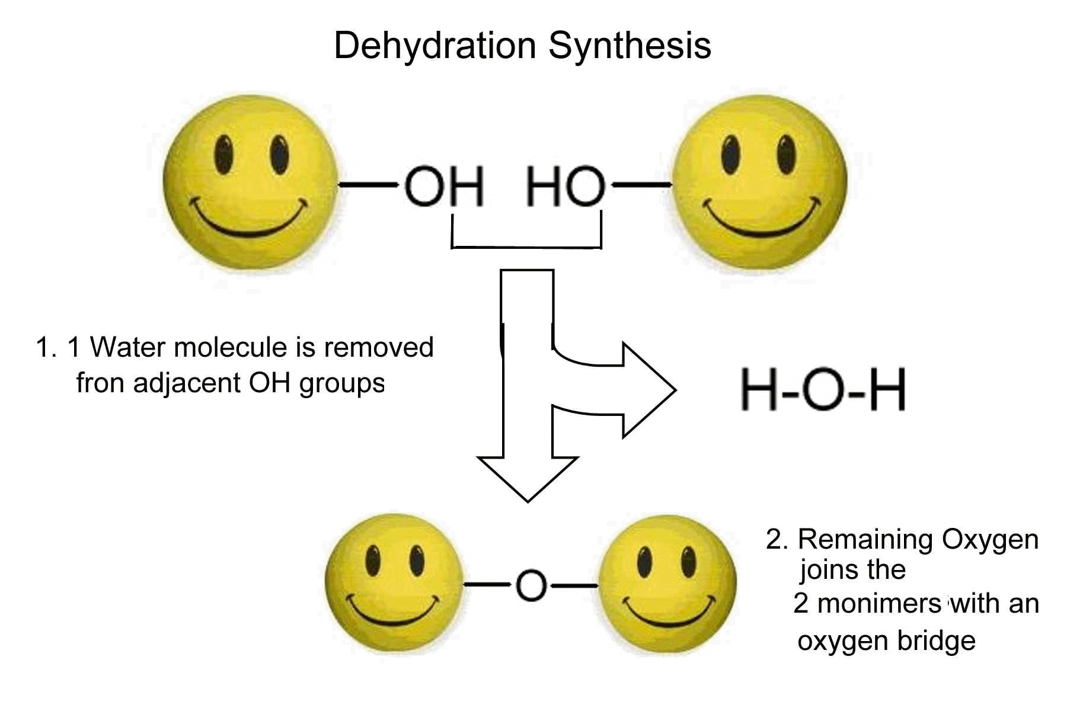
Carbohydrate molecules are joined by Dehydration Reactions (-H₂O)
Di/Oligio/Polysaccharides are broken apart by Hydrolysis Reactions (+H₂O)

Slide 47
Dehydration/Hydrolysis

Slide 48
Carbohydrate molecules are joined by Dehydration Reactions (-H₂O)
Di/Oligio/Polysaccharides are broken apart by Hydrolysis Reactions (+H₂O)

Slide 49
Miscellaneous
Applications

Slide 50
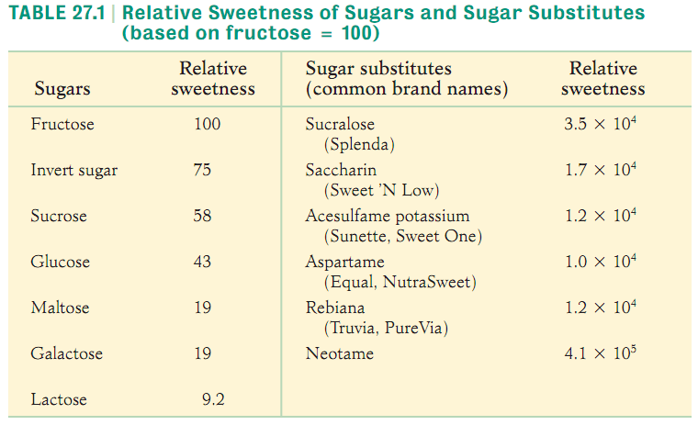
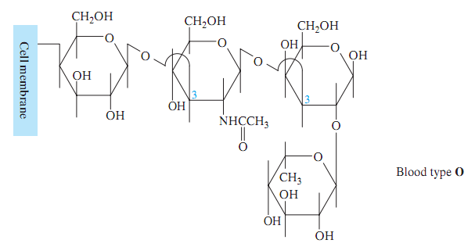
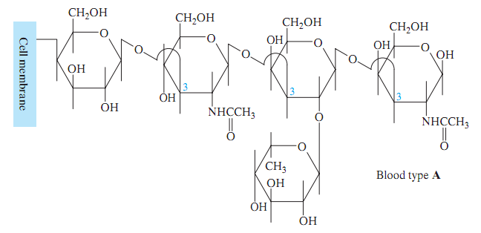
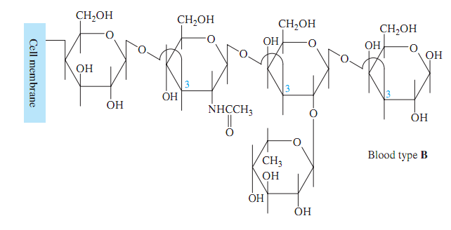
Sweeteners
Antigens / Blood Types

